Slide 1


Cross-Lingual and Multi-Task Learning with Knowledge Distillation for Emotion Recognition in Low Resource Romanian
Slidesgo School
You must tell the audience what are you going to show them
(traditional approach)
Matei Vlad Cristian
AI Master II
University Politehnica of Bucharest
Notes:
Hi ! In this presentation I’ll present my work where the primary goal is the automatic recognition of emotions for low resourse Romanian language.

Slide 2

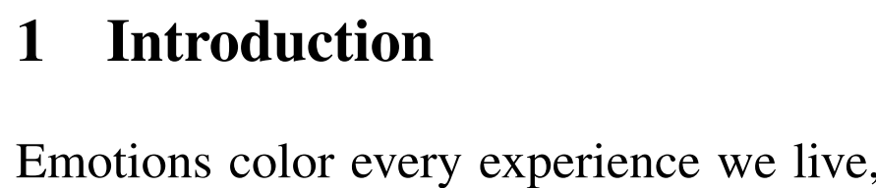
Importance of Emotions Automatic Recognition
generators of great harm
(manipulating voters)
facilitators of enormous progress
(commerce)
Notes:
Emotions color every experience we live, representing a central aspect of relationships between people. Research in this area has intensified, emotion analysis being a task that has been intensively researched in the Natural Language Processing (NLP) community for years [7]. In her book 1 , Dr. Rosalind Picard described automatic emotion recognition as: "Giving Computers Emotional Skills". So using automatic emotion recognition can generate great harm, but also facilitate enormous progress. About this ethic problem, and the correct balance writes Mohammad in his paper.

Slide 3
Why this study for Romanian language ?
Unsaturated Research
Insufficient researchers to advance new discoveries for the Romanian language. Opportunity and potential exist for new experiments.
Low-Resource Language
As the availability of datasets dedicated to emotions analysis is severely limited, the exploration of diverse range of approaches is needed.
2
Notes:
So. Why this study for our language ? First, we can say that we have unsaturated research in this specific task, or area. I think there is still potential to discover new interesting expriments. And secondly, Romanian is a low-resource language, so the availability of the datasets is limited, so we can still explore a diverse range of approaches to enrich our solution, and this is really needed in order to have good results.

Slide 4
What are the objectives ?
01
Train BERT-base-ro on three tasks on Romanian language: (i) emotion recognition, (ii) sentiment analysis, (iii) news categorization. These models will be the main teachers.
02
03
Each of these models will be enriched by using two cross-lingual domain adaptation methods: (i) Multi-Stage Cross-Lingual, (ii) Multi-Task Cross-Lingual Same-Domain.
Within a multi-task learning framework, investigate how the tasks influence one another. To ensure that the information is effectively harmonized, a technique of self-knowledge distillation with teacher annealing will be used on the initial teachers.
3

Slide 5
Related work

Slide 6
The Datasets

Slide 7
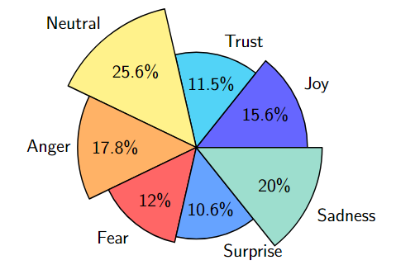
Datasets Establishment
Redv2
01
It contains 5,449 manually verified tweets
The original split - 75% train, 10% validation, and 15% test will be used in this research.
Emotions Task
SOTA: 0.668 Ro-BERT F1.
4
Notes:
REDv2 2 [5] is a large available resource for emotion analysis in Romanian language. Its second version includes 5,449 manually verified tweets, each marked with one of these seven emotions as you can see in the figure. The SOTA on this dataset is 0.668 F1 score. Score obtained with Ro-BERT.

Slide 8
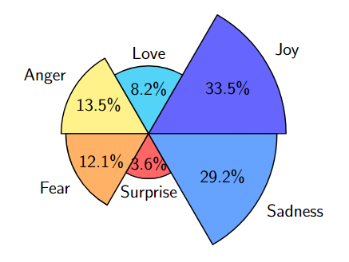
Datasets Establishment
Emotion Dataset
01
It contains 20K English tweets
The original split - 80% train, 10% validation, and 10% test will be used in this research.
Emotions Task
4
Notes:
Redv2 English pair dataset will be the emotion dataset. It’s made of 20.000 English Twitter messages, categorized into six basic emotions as you can see in the figure.

Slide 9
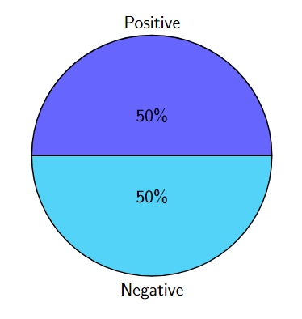
Datasets Establishment
LaRoSeDa Dataset
02
Includes 15K Romanian reviews collected from one of the largest e-commerce platforms.
The original split – 11K train, 1K validation, and 3K test will be used in this research.
Sentiment Task
4
Notes:
For the sentiment task, I’ll use LaroSeDa as the main Romanian dataset. It includes 15K Romanian reviews collected from one the largest e-commerce platforms.

Slide 10
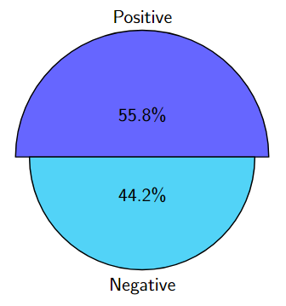
Datasets Establishment
SST-2 Dataset
02
Selected ~70K English sentences extracted from movie reviews.
The original split – 96% train, 1.3% validation, and 2.6% test will be used in this research.
It can be observed that there are various domains, not only in terms of language but also regarding the source domain of the datasets.
Sentiment Task
4
Notes:
The English dataset used will be SST-2. I’ve selected around 70K English sentences, sentences part of movie reviews.

Slide 11
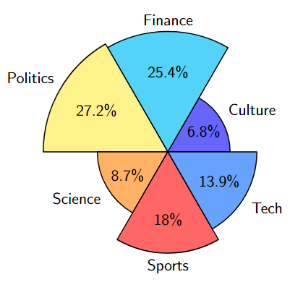
Datasets Establishment
MoRoCo Dataset
03
Selected ~33.5K Romanian and Moldovian samples of text collected from the news domain.
The original split – ~65% train, 17.6% validation, and 17.6% test will be used in this research.
News Categorization Task
4
Notes:
As for the news categorization task, the Romanian selected dataset is MoRoCo. It contains somewhere around 33K Romanian and moldovian news articles. You can see the labels in this figure.

Slide 12
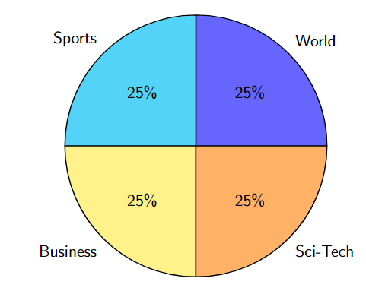
Datasets Establishment
Ag News Dataset
03
Vast collection of English news articles, comprising over 1 million examples
Only a subset of 120K examples for training and 7.6K will be used.
News Categorization Task
4
Notes:
The Moroco’s pair would be AgNews – a large news corpus, from which I’ve selected a subset of 120K examples. This dataset have only 4 main labels.

Slide 13
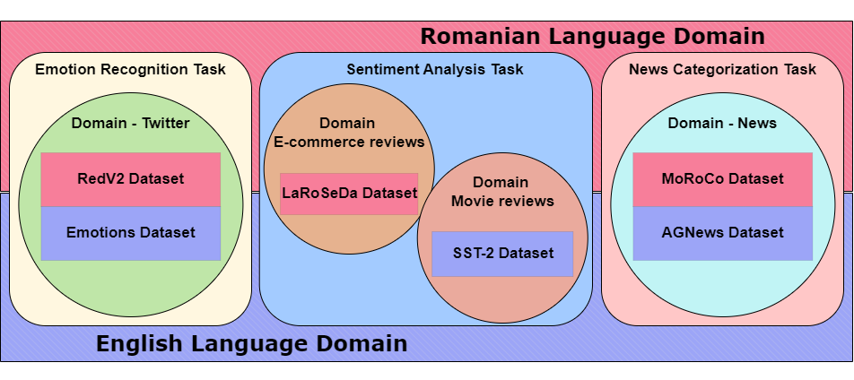
4
Notes:
Here, you can observe the datasets and the domains they belong to. On one hand, there are the specific domains, and on the other, the language domain to which they belong, along with the relationship between them.

Slide 14
Methods

Slide 15
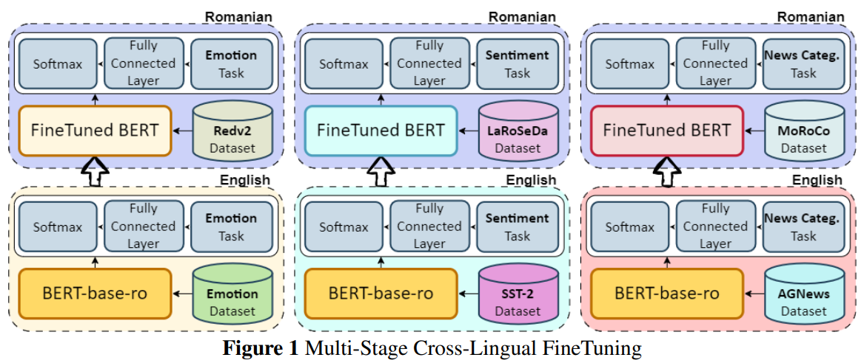
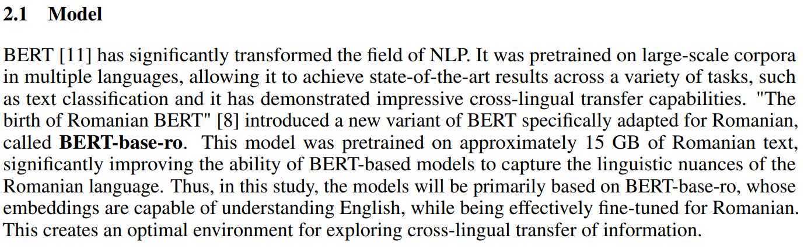
Notes:
Trying to take advantage of the fact that the model used is BERT-base-ro, which has been pre-trained on a multi-bert architecture that knows both English and Romanian, I attempted a domain adaptation method that could be called multi-stage cross-lingual fine-tuning. This involves simple fine-tuning on the English dataset, and then the resulting model going for another fine-tuning phase, this time with the help of the Romanian dataset.

Slide 16
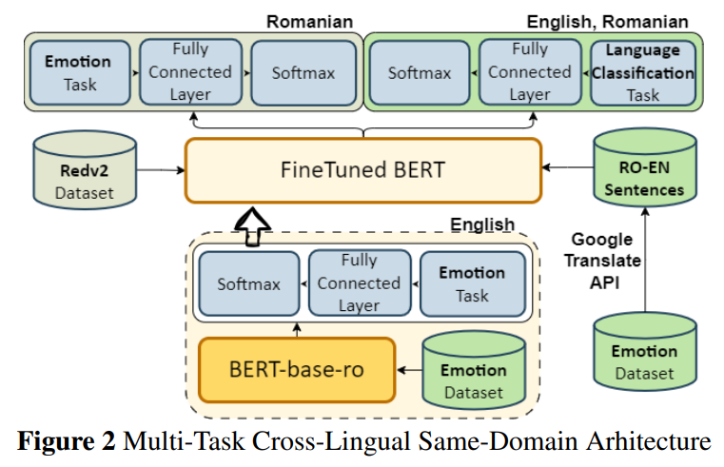
Notes:
The second method attempting cross-lingual learning is represented by this architecture inspired by Adversarial Deep Averaging Networks (ADAN). What I accomplished was translating the English dataset into Romanian and creating a new parallel dataset, where the label indicates the language of the text. Then, starting from the model fine-tuned on the English dataset, a multi-task learning approach was applied, which, on one hand, solves the main task with Redv2, and on the other hand, learns to differentiate the language in the parallel dataset.

Slide 17
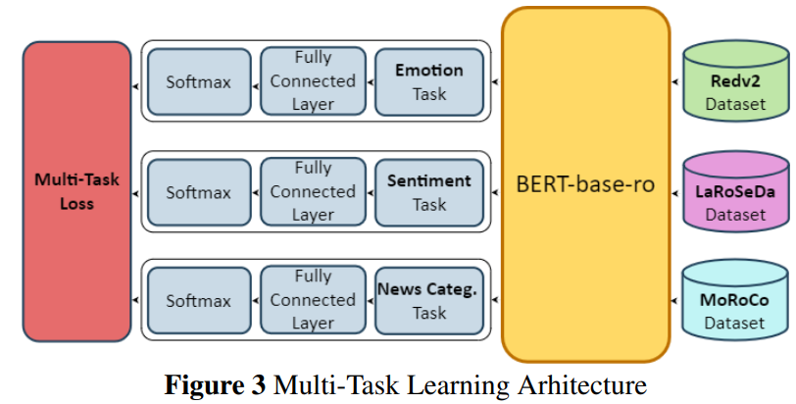
Notes:
From this method forward, I will focus on optimization, setting aside the benefits of a cross-lingual environment. Here, I used a multi-tasking environment to obtain a model specialised in all three tasks: emotion classification and the other two auxiliary tasks.

Slide 18
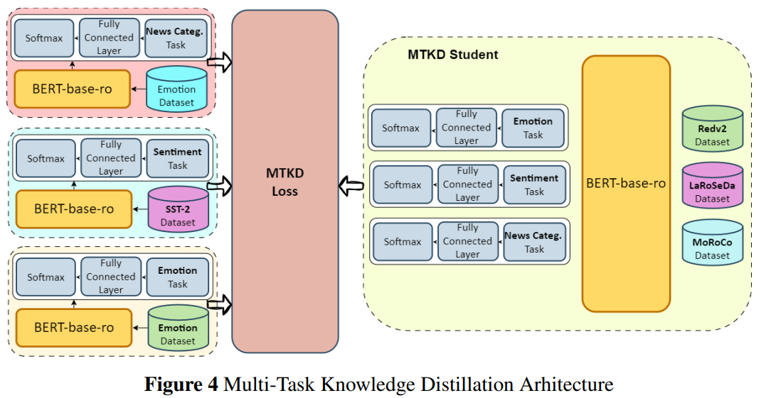
Notes:
The last architecture is improved by using self-knowledge distillation. This involves training a student, which is a multi-tasking model, with the help of teachers that are the same size as the student but specialized in a single task. The transfer of information is done through distillation. Distillation benefits from what could be called 'dark knowledge,' meaning the information hidden behind a simple final prediction. Thus, the teachers not only provide the correct answer but also provide a signal indicating how confident they are in the answer and to what extent, which is scaled through temperature.

Slide 19
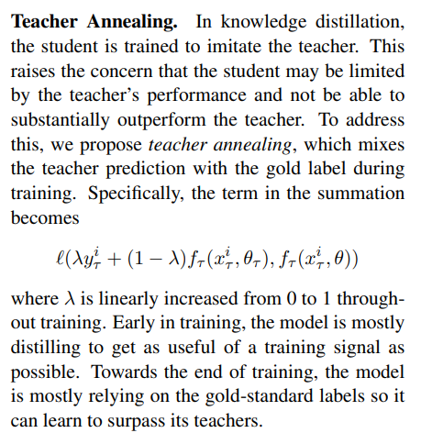
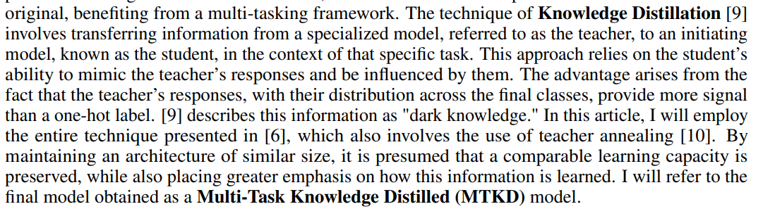
Born-Again Multi-Task Networks
2
Notes:
The method presented is also known as 'Born Again Multi-Task Networks.' Finally, I will optimize the method using the teacher annealing technique. Teacher Annealing (TA) [11] is a method from knowledge distillation that mitigates the increasing gap between the teacher and the student models. Sometimes, when transitioning from a specialized teacher to a student who is still in the learning process, there can be a gap, which can be better bridged if the student relies more on the teacher at the beginning of the learning process and becomes more independent as time passes. This can be controlled through the variable alpha or lambda, as shown in the formula image, lambda linearly increased from 0 to 1. (the standard setting).

Slide 20
Results

Slide 21
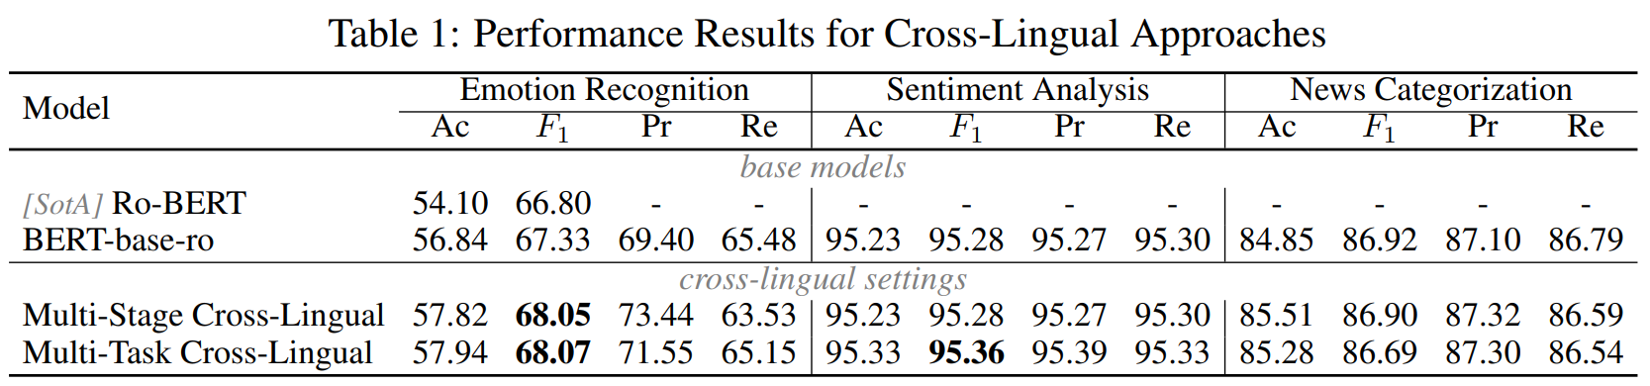
Notes:
As for the performance obtained from the cross-lingual approaches, no impressive results were achieved. Where the datasets were more consistent, and the results were already somewhat saturated (95%) or (86%), no higher scores were obtained. However, for the main task, the improvement was 0.7%. This small gain can probably be explained by the fact that the task of distinguishing between English and Romanian was too simple, and the model tended to overfit after just a few iterations. Additionally, I did not use a more complex loss function, such as contrastive loss or something else. Although I also tried other solutions, such as changing the sign in the loss calculation to introduce confusion instead of discrimination and to bring the English and Romanian embeddings closer together in the dimensional space, this approach did not work

Slide 22
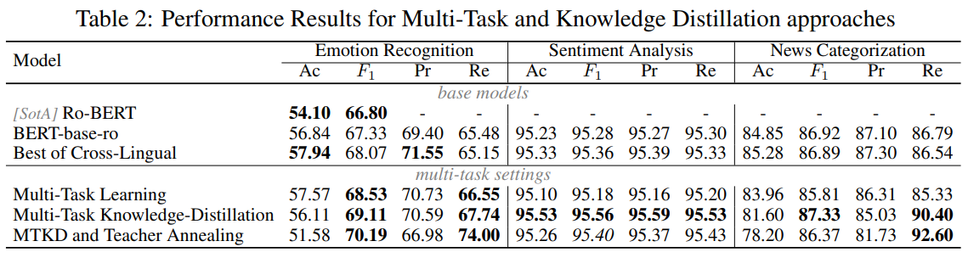
Notes:
Here, much improved results are achieved. Significant percentage increases can be observed with each added method, approximately 1 F1 point for multi-task learning, knowledge distillation, and teacher annealing, respectively. So the results are good.

Slide 23
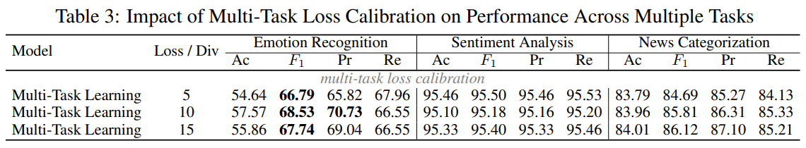
Notes:
To balance the contribution of each task in the unified environment, I tried to balance the situation by dividing the loss of the auxiliary tasks by 5, 10, and 15. Intuitively, it was found that dividing by 10, which was intuitive since the secondary datasets are approximately 10 times larger than Redv2, yielded the best results.

Slide 24
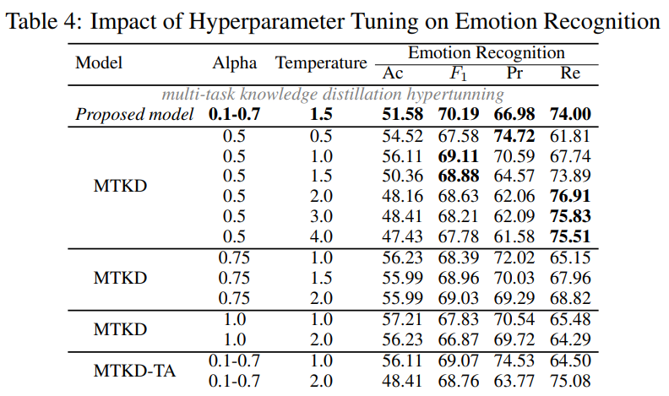
Notes:
Here, I tried to vary the hyperparameters alpha and temperature. Some trends can be observed. The precision decreases, but recall increases as the temperature rises, while alpha remains fixed. It is also observed that when alpha is higher, meaning the student relies more on the ground truth than on the teacher, the F1 score is higher, and both precision and recall start from higher values. Section 3 demonstrates the benefit provided by the teachers. The final section demonstrates the advantage of learning with teacher annealing.

Slide 25
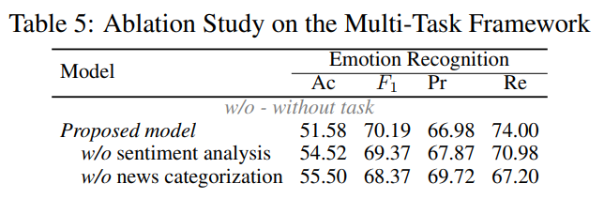
Notes:
This ablation study demonstrates that each task contributes positively to the final result, as excluding one of the tasks leads to a worse final outcome.

Slide 26
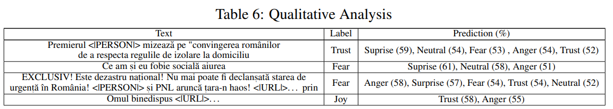
Notes:
Considering the final results, since this is a multi-label classification problem, the results are still far from qualitative. The final F1 score is only around 70%, which is still pretty low and means that the predictions are aligned with the measured performance. As it can be observed, in the first example, the model gives several labels, and words like "convingerea" (conviction) keep suggesting Trust, whereas "izolare" (isolation) would suggest Anger. Therefore, I would not say that the understanding of the model is somehow far from being correct. In the second example, the lack of punctuation probably misled the model in predicting Surprise, but the confusion between Fear and Anger does not seem very serious. However, in the last two examples, the model still seems to be confused and is unable to make the right decisions.

Slide 27
Conclusions
1
2
3
02
F1 – 67.33%
0.7%
~3%
BERT-base-ro model – Emotion Recognition Task
By using cross-lingual
techniques.
Using multi-task, knowledge distillation and teacher annealing
12
Notes:
In conclusion, I successfully trained a model that solves the main task of recognizing emotions in text with an F1 score of approximately 67.33%. Additionally, I was able to draw some conclusions regarding the cross-lingual techniques used, which brought a slight improvement of only 0.7%. Ultimately, the true performance came from multi-task learning, where, through knowledge distillation and teacher annealing, I managed to improve the score by approximately 3 percentage points. A successful method. Thank you!

Slide 28
Thank you
Research advisor:
Șl. Dr. Ing. Dumitru-Clementin Cercel
University Politehnica of Bucharest

